Slide 1

Topic 1: Overview

Slide 2
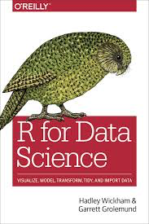
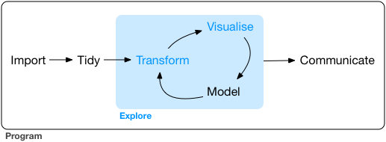
Objective
“The course will benefit operational research practitioners who support data-driven decision making within their organisation, and are interested in exploring new tools, workflows and methods to generate insights, and communicate these to key stakeholders”
https://r4ds.had.co.nz

Slide 3

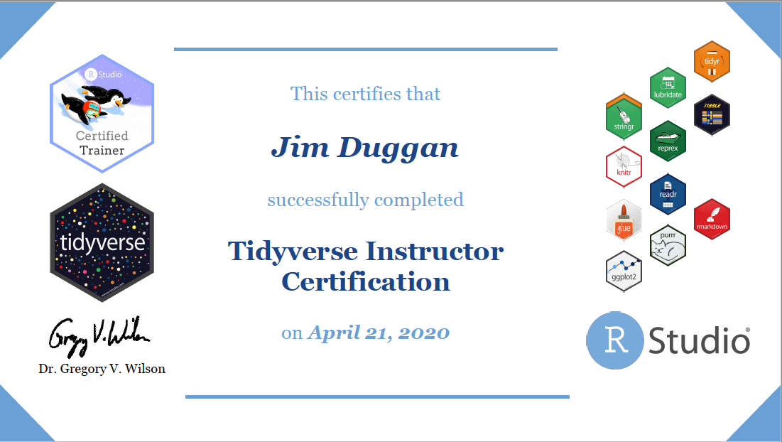
Instructor –Jim Duggan
Lectures in
Programming (R, MATLAB),
Modelling & Simulation
Research interests:
System Dynamics
Computational Epidemiology
Data Science
https://education.rstudio.com/trainers/people/duggan+jim/
https://twitter.com/_jimduggan

Slide 4
Course Overview
Topic | Description
Day 1
1 | Introduction to R and R Studio Cloud
2 | Exploratory Data Analysis: the tibble and ggplot2
3 | Functions, Vectors and Lists
4 | Introduction to Functionals with purrr
5 | Data Transformation I with dplyr
Day 2
6 | Data Transformation II with dplyr
7 | Statistical Transformation with ggplot2
8 | Advanced Functionals and Modelling with purrr
9 | Exploratory Data Analysis - Case Study using aimsir17

Slide 5
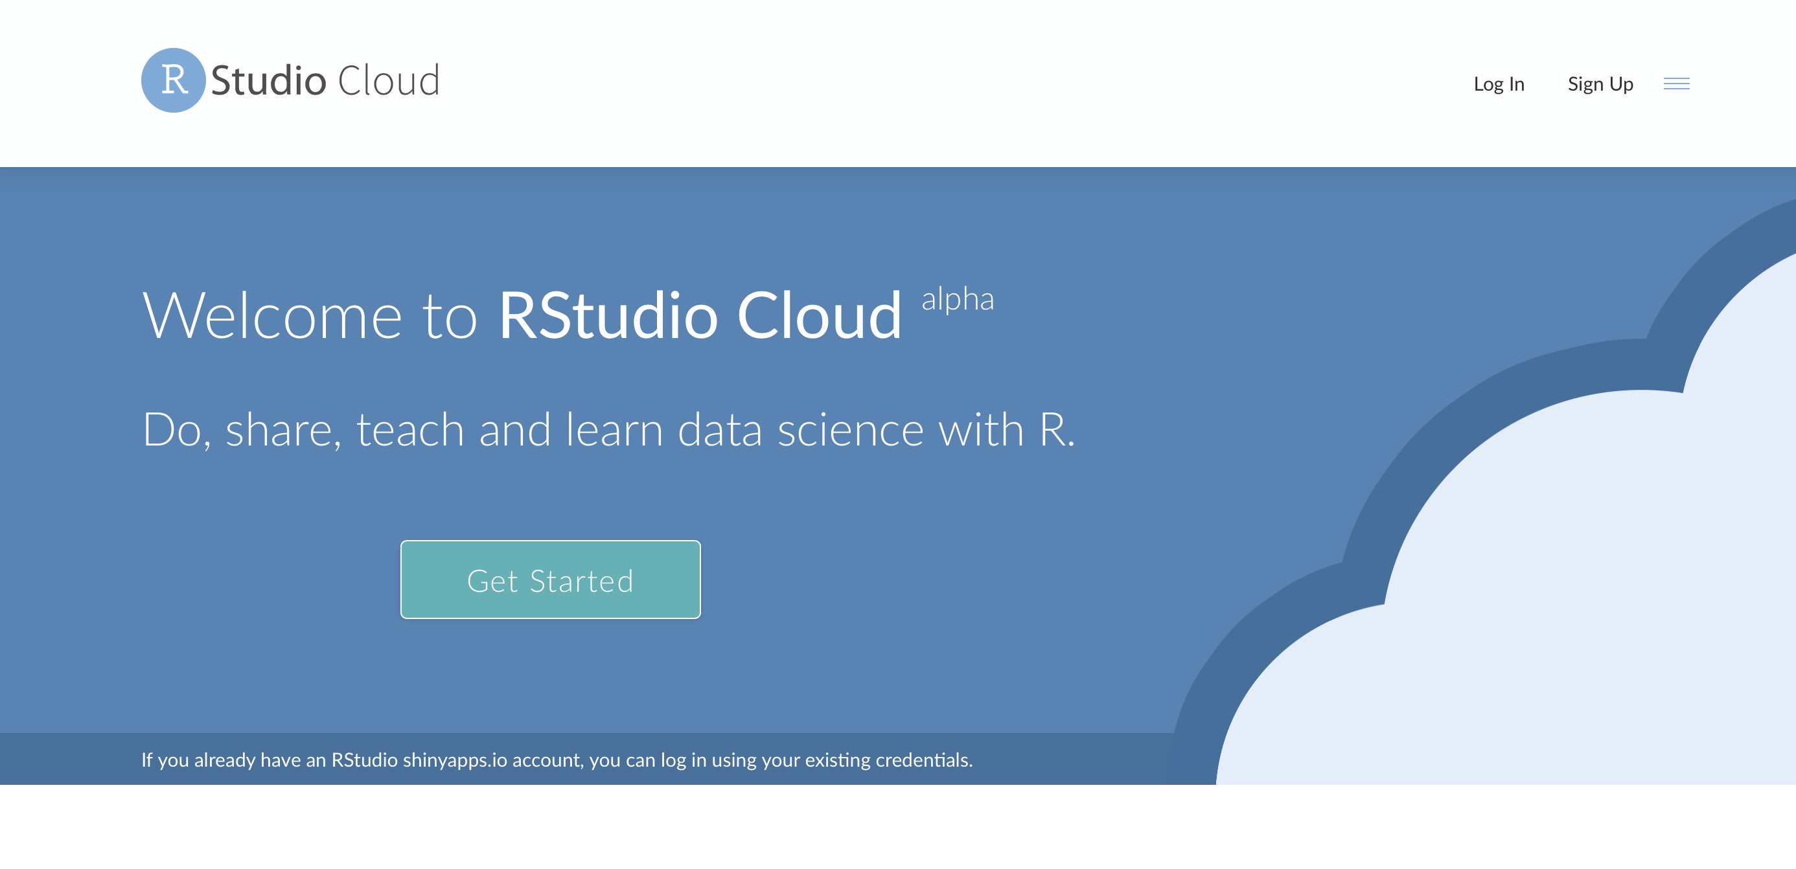
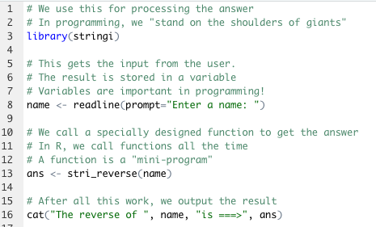
The R Project for Statistical Computing
R’s mission is to enable the best and most thorough exploration of data possible (Chambers 2008).
It is a dialect of the S language, developed at Bell Laboratories
ACM noted that S “will forever alter the way people analyze, visualize, and manipulate data”

Slide 6
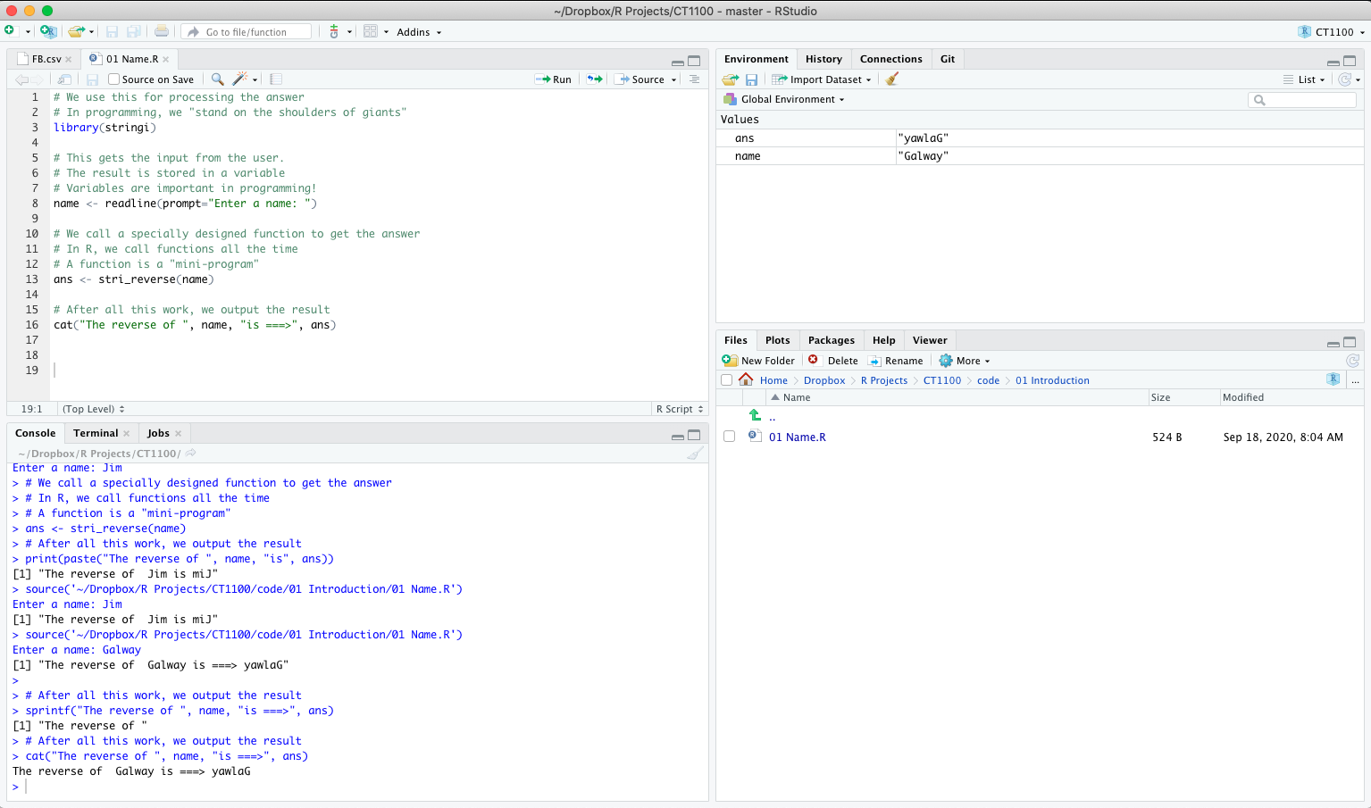
First Steps: RStudio Cloud!

Slide 7
(1) Create your account on https://rstudio.cloud and login

Slide 8
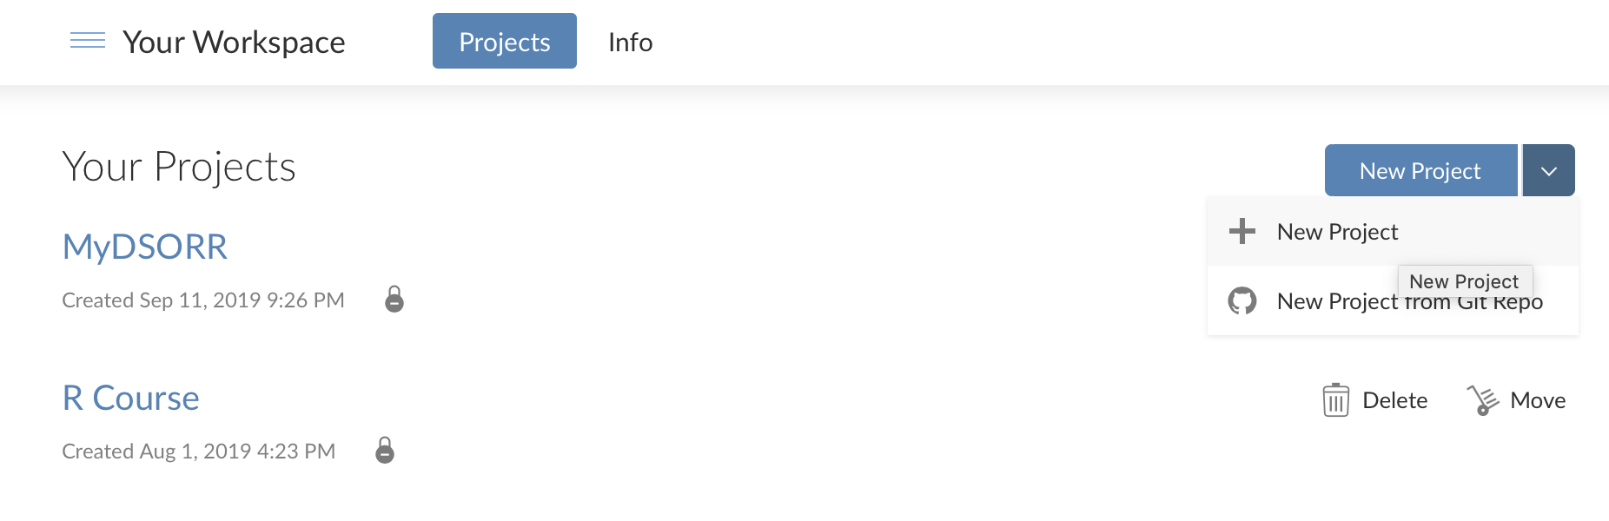
(2) In your workspace, create a project

Slide 9
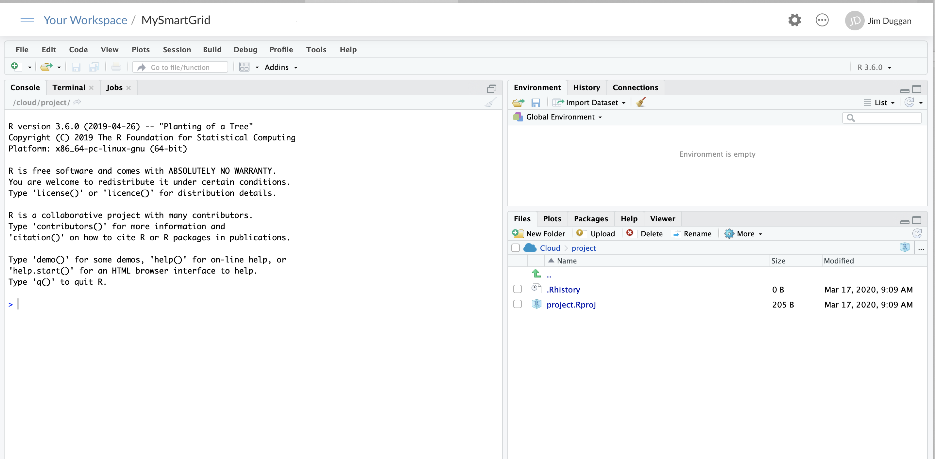
(3) Name the project (e.g. MySmartGrid)

Slide 10
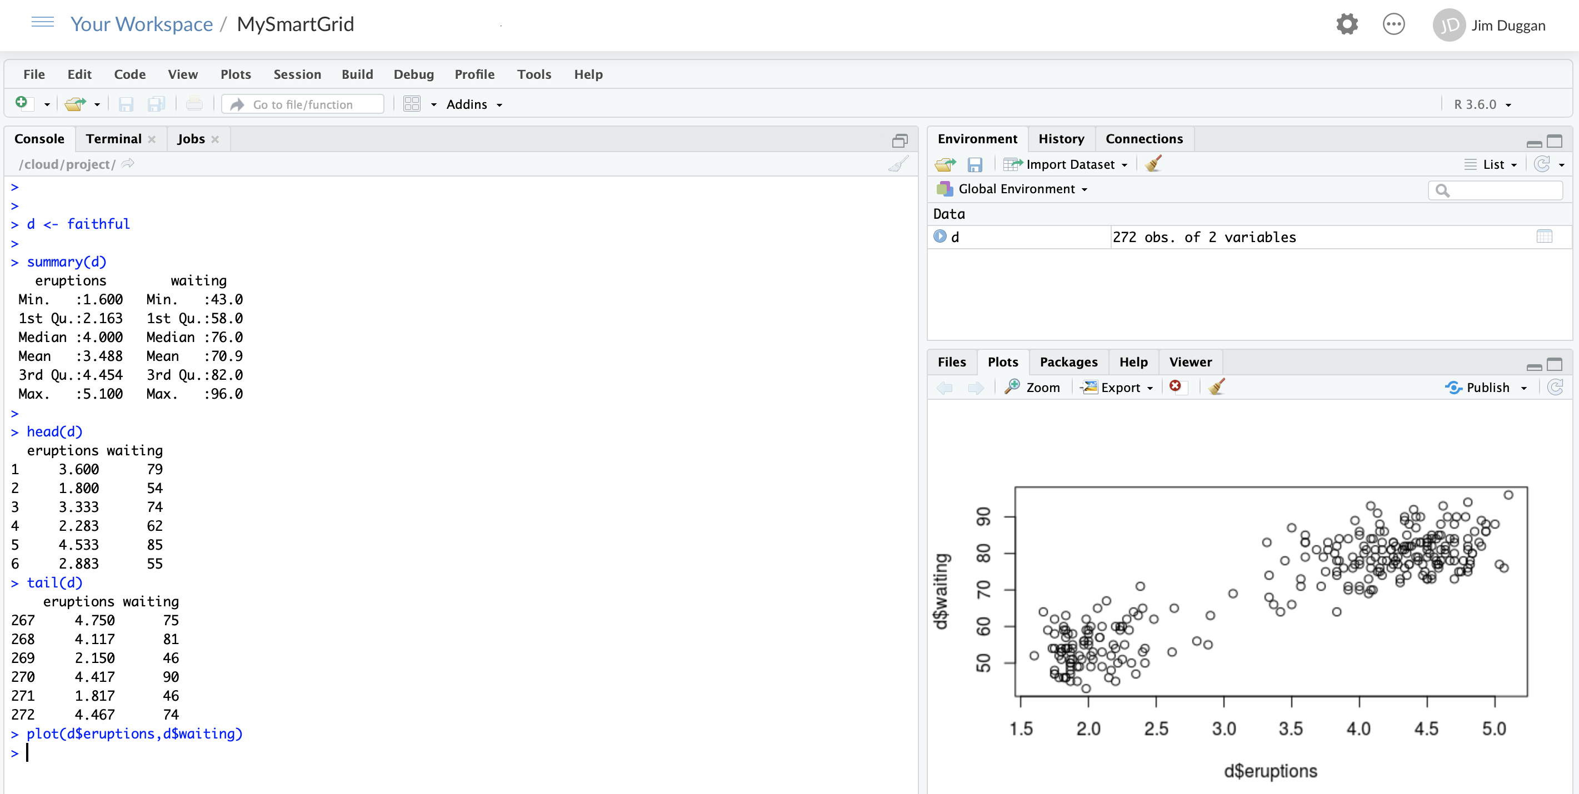
(4) Run some R code in Console

Slide 11
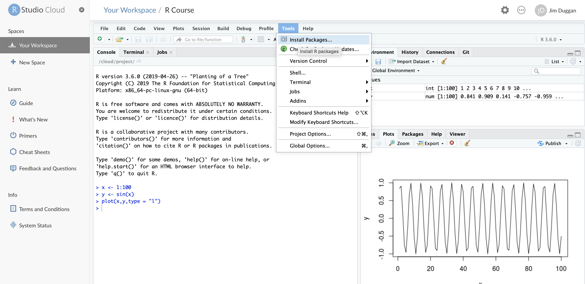
(5) Install required packages

Slide 12
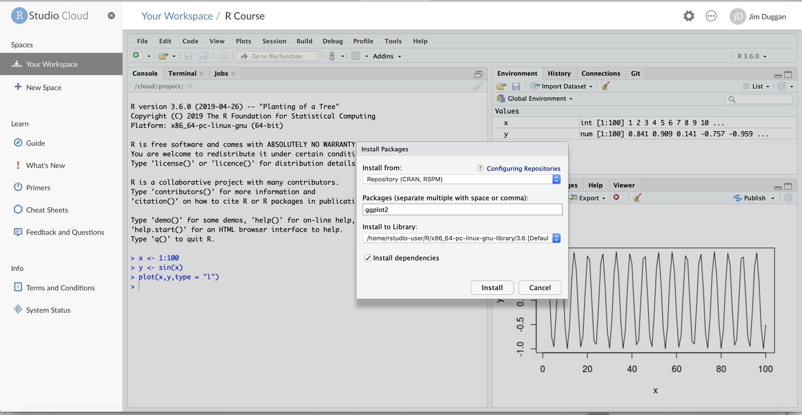
(6) For example, ggplot2

Slide 13
(7) Packages required
Package | Purpose
ggplot2 | Produce graphics for data
dplyr | Analysis of data held in tibbles/data frames
aimsir17 | 2017 Weather data for Ireland
purrr | To iterate over data structures
tidyr | To tidy rectangular data, and to nest data sets

